Slide 1
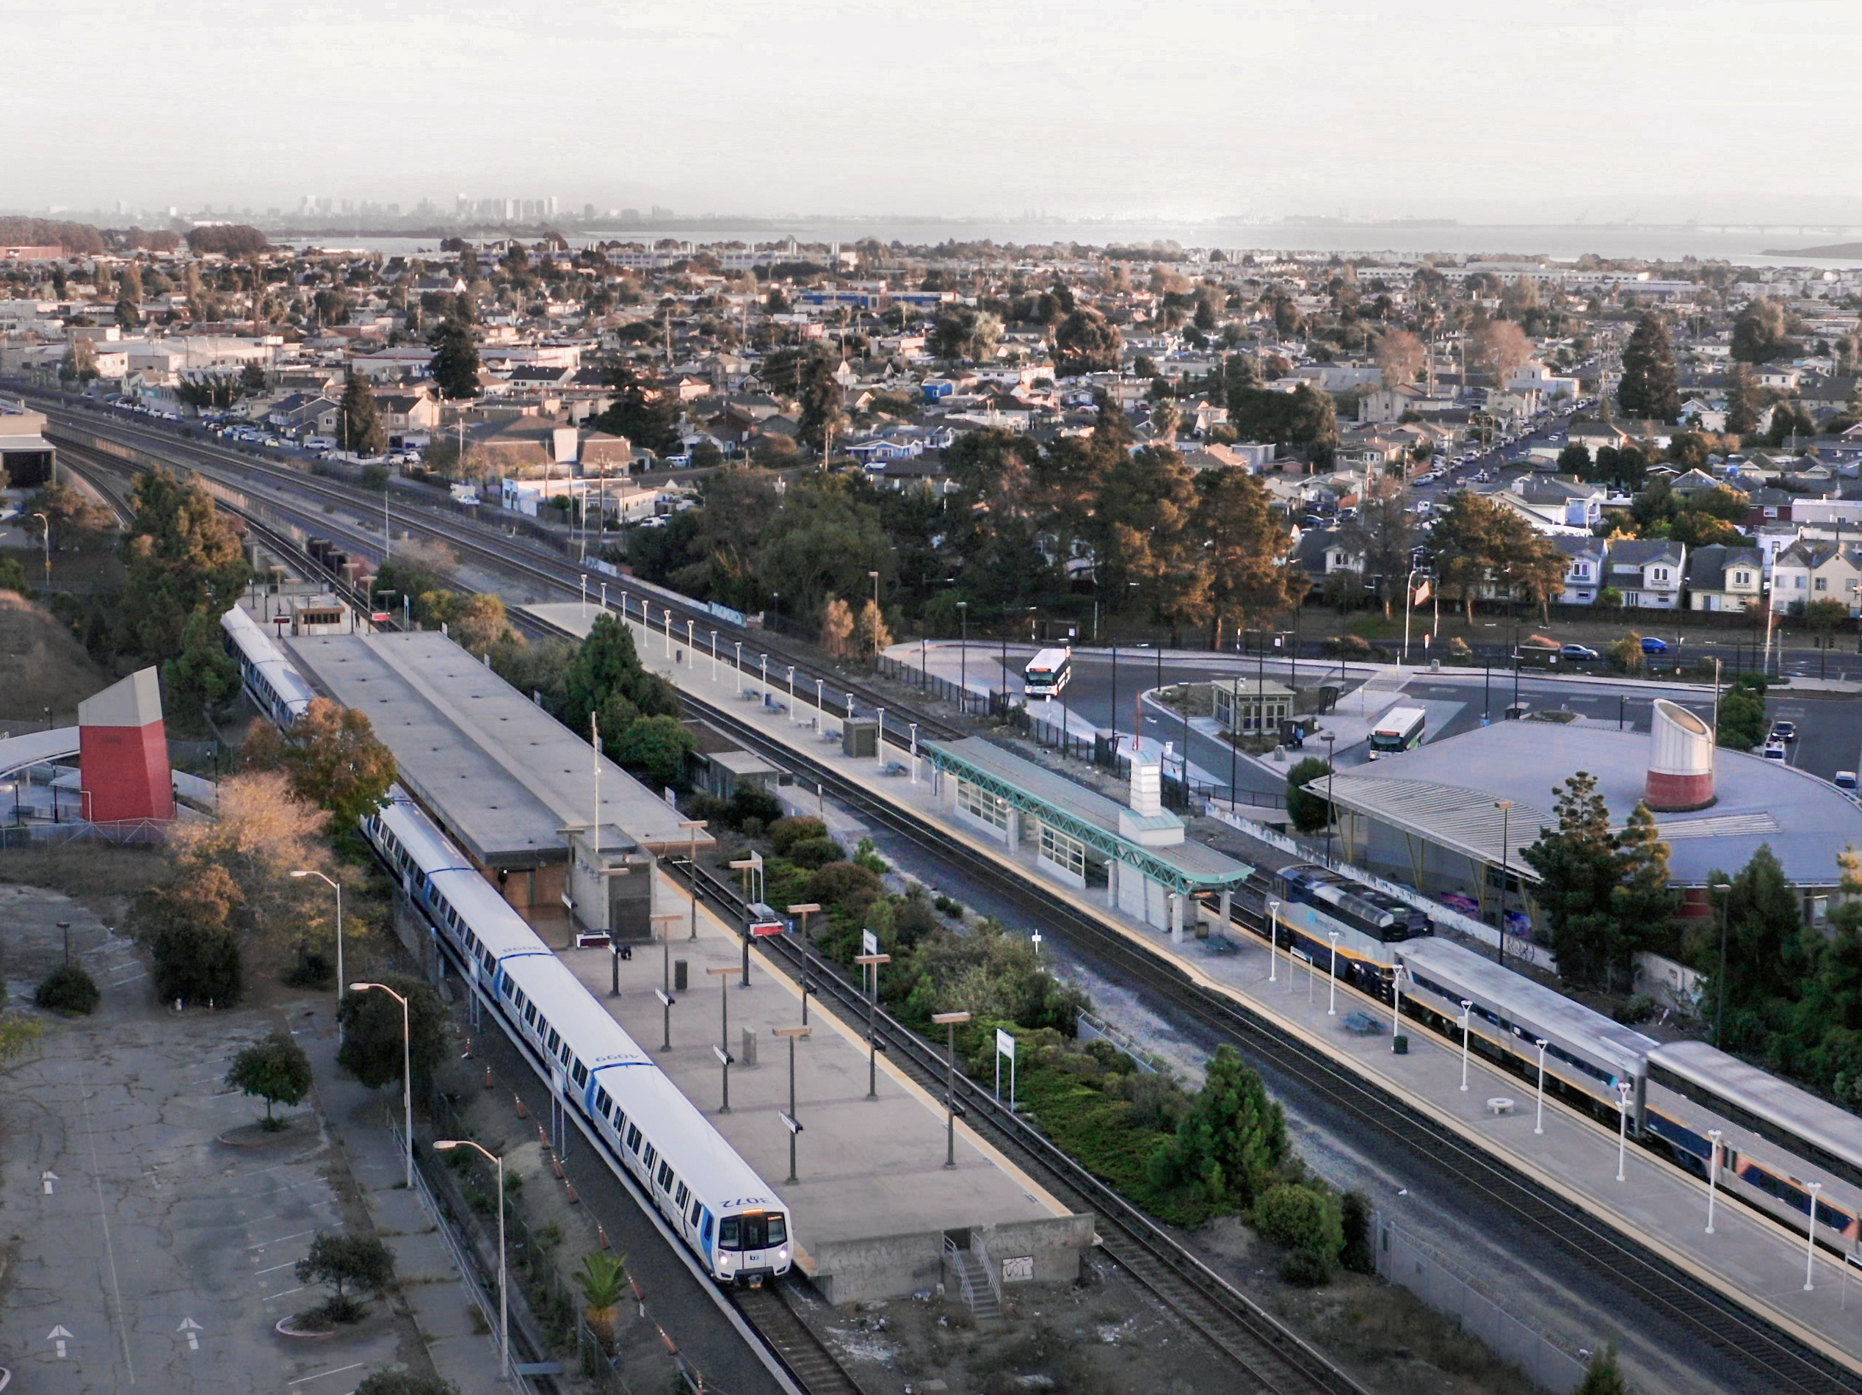
South Beach|Rincon|Mission Bay Neighborhood Association
November 14, 2022
6:00 p.m.

Slide 2
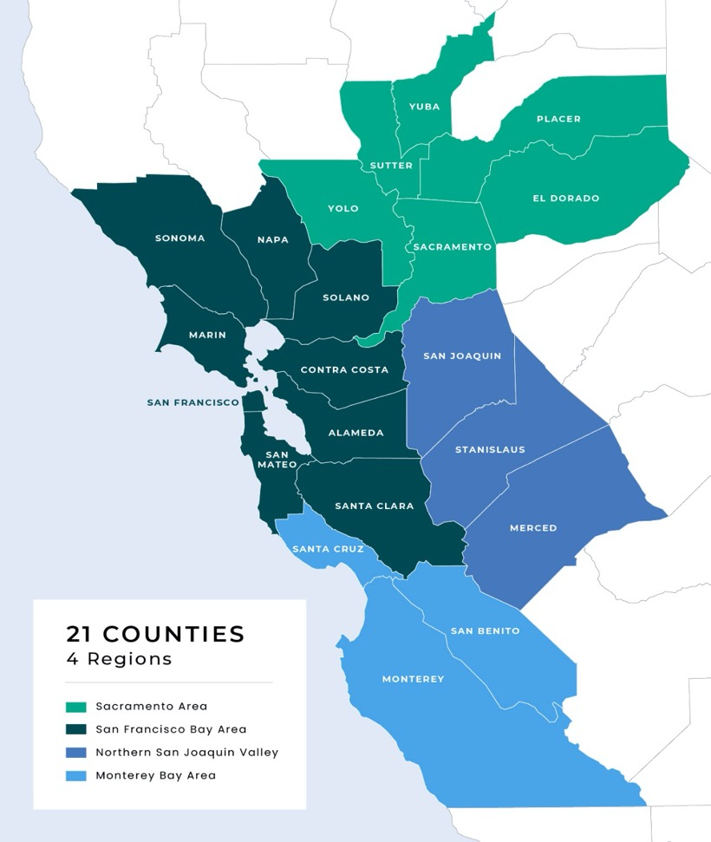
Northern California’s Megaregion Today
Economy, Jobs & Housing:
Fifth largest megaregional economy in country
Jobs and affordable housing imbalance
Roadway Congestion & Climate Risks:
Persistent traffic
Climate - and health-damaging air pollution
Passenger Rail Service & Infrastructure:
Inconvenient, disconnected train network with limited routes and service
One rail crossing of Bay (BART Transbay Tube)
Notes:
Nicole
The Northern California Megaregion includes 21-Counties as shown on the map. Link21 gets its name from the 21-county megaregion.
Our region is a thriving and cherished place to live, but we do face challenges that will only get worse as our population continues to grow.
As the fifth largest megaregional economy in the U.S., residents suffer a high cost of living that has resulted in moving further away from their jobs and school in search of affordable housing.
Ours is a region where people regularly live, work, and recreate across County lines which means longer travel times and hours logged on the road, resulting in persistent traffic and travel delays on our local freeway systems.
Pre-pandemic, an average Bay Area commuter spent almost 4 days per year stuck in traffic and the BART’s transbay tube – the only rail crossing between the east bay and San Francisco/Peninsula, was at or exceeding its capacity.
We already have seen our freeways get back to the congestion that it was, and our train system is experiencing that rise in ridership as well as we come out of the pandemic.
As transportation is a major contributor to pollution and climate change, as a result, our region faces health damaging air quality that must be addressed.

Slide 3
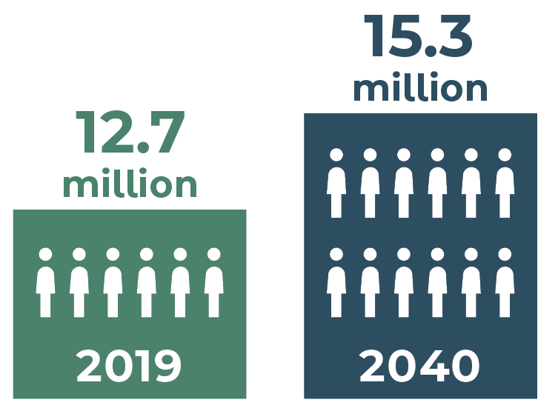
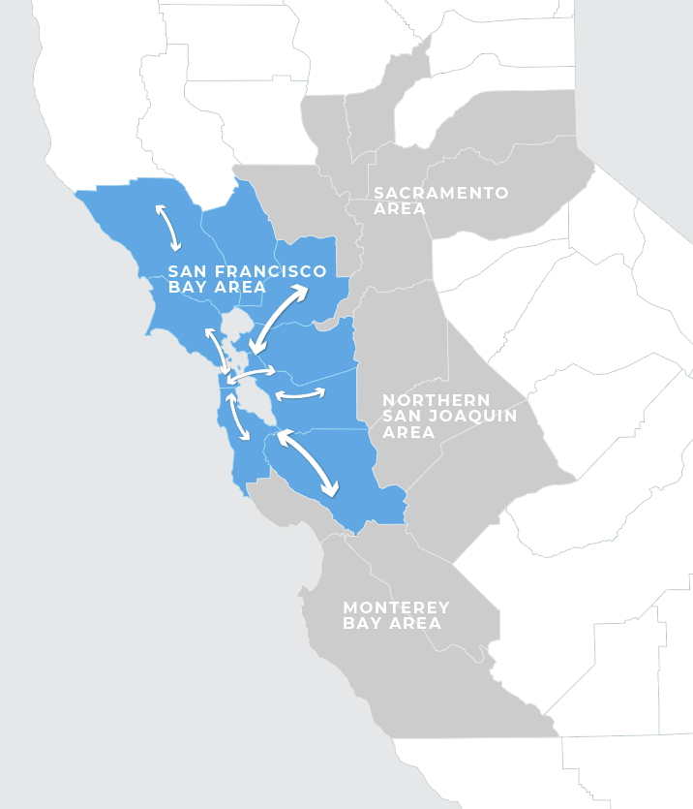
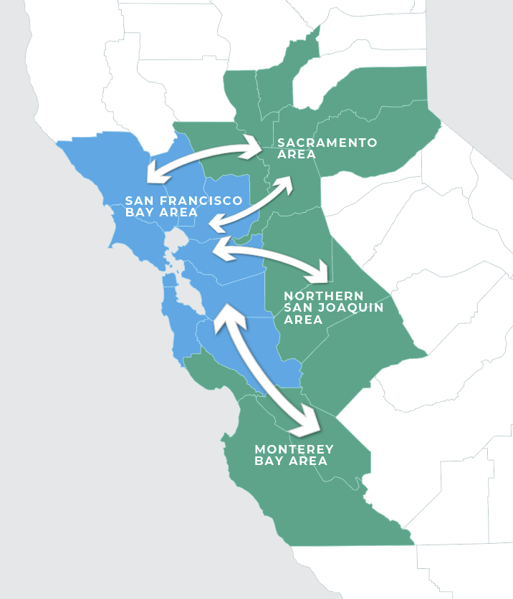
Projected Growth from 2015 to 2040
20%
In population
26%
In daily trips within
San Francisco Bay Area
(estimated 28 million)*
64%
In daily trips between
Bay Area and other counties
(estimated 800,000)*
* Projected increase from 2015 to 2040
Notes:
Nicole
Without solutions, these challenges will only get worse as our population is expected to reach 15 million by 2040.
This growth will put even more demand on our transportation system.
Through an early market analysis, we identified that by 2040, the daily trips within the SF Bay Area will increase by 26%
The daily trips between the Bay Area Counties and other Megaregional counties, an increase of 64%.
This growth and travel demand, requires solutions that take people out of their cars and onto trains –giving them more travel options.

Slide 4
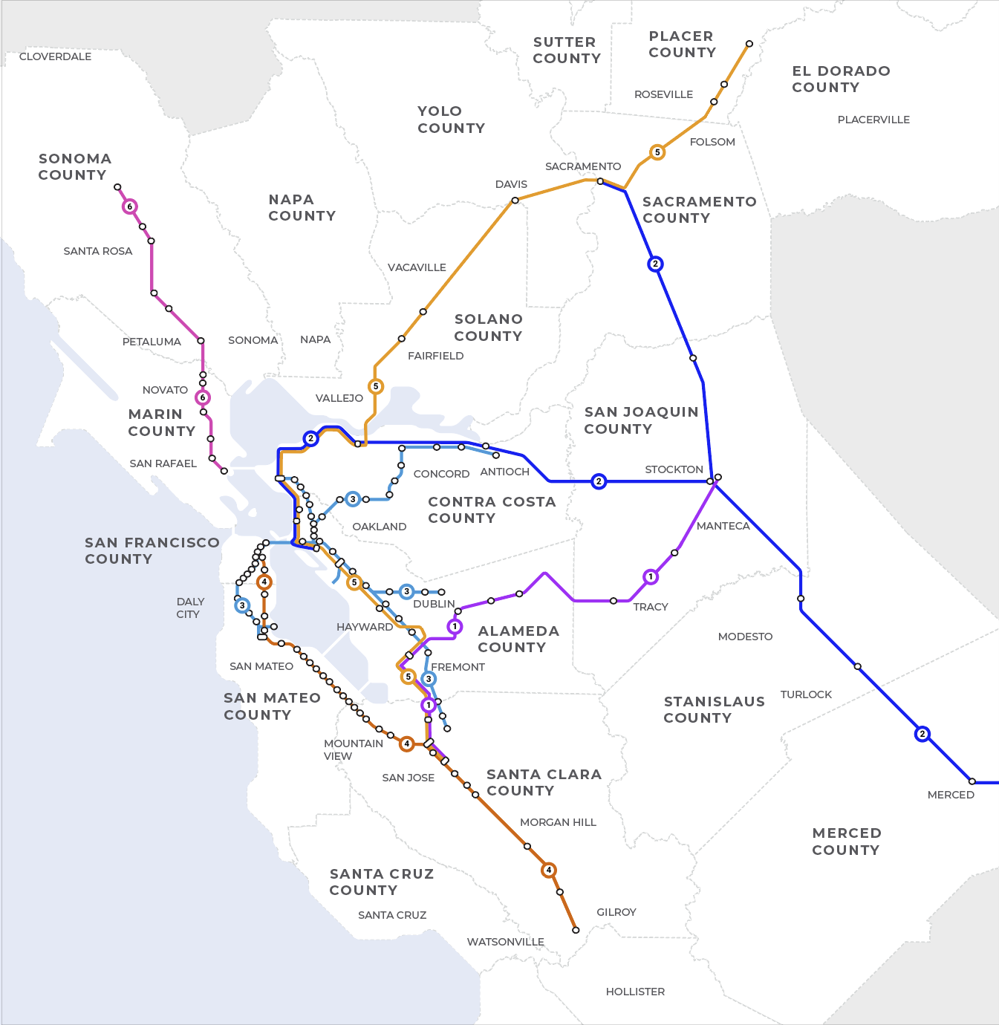

Our Train
Network Today
Altamont Corridor (ACE)
Amtrak San Joaquin
Bay Area Rapid Transit (BART)
Caltrain
Capitol Corridor
Sonoma-Marin Area Rail Transit (SMART)
Transfer Station
Station
Notes:
Nicole
Today our rail network is made up of several regional rail operators who run longer distance services that connect people throughout the megaregion into the Core of the Bay Area and BART which provides frequent metro commuter service across five counties.
Although we have a fair amount of rail service today, it doesn’t meet our growing needs.
It is disconnected, sometimes inconvenient and ultimately is not competitive with cars, especially for medium- to long-distance trips.

Slide 5

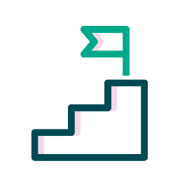
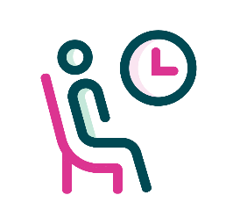

Link 21 Goals & Objectives
PROMOTE EQUITY AND LIVABILITY
Connect people and places
Improve safety, health, and air quality
Advance equity and community stability
SUPPORT ECONOMIC OPPORTUNITY AND GLOBAL COMPETITIVENESS
Improve access to opportunity and employment
Connect major economic, research, and
education centers
Enable transit-supportive and equitable land use
ADVANCE ENVIRONMENTAL STEWARDSHIP
AND PROTECTION
Increase climate change resilience
Reduce greenhouse gas emissions
Conserve resources
TRANSFORM THE PASSENGER EXPERIENCE
Provide better service
Improve reliability and system performance
Build ridership and
mode share
Notes:
Nicole
As a Program of several Projects, Link21 will include network improvements for both BART and Regional Rail.
The Programs goals and objectives are listed here
Ultimately, we want to transform the passenger experience, promote equity and livability, support economic opportunity and advance environmental protection.
These goals and objectives serve as the foundation for our Program and are how we will identify, develop and evaluate concepts that will evolve into Projects for Link21.
Our Program is looking to reach more communities with better service using new train technology and infrastructure like new tracks, structures and signaling.
The benefits will be felt across our Megaregion; elevating equity, expanding economic opportunity, and creating environmental resilience.

Slide 6
Link21 Program Timeline
PHASE 1 (2022 – 2024)
PHASE 0 (2019 – 2022)
PHASE 2 (2024 – 2027)
PHASE 3 (2028 – 2039)
PROGRAM
DEFINITION
• Business Case Framework
• Problem & Vision Statement
• Goals & Objectives
PROJECT
IDENTIFICATION
• Preliminary Business Case
• Identify Project Concepts
PROJECT
SELECTION
• Intermediate Business Case
• Project Alternative(s)
• Environmental Review
• Final Business Case &
Implementation Strategy
PROJECT
DELIVERY
• Funding Strategy
Design
• Construction
• Testing & Commissioning
• Ready for Service
Notes:
Nicole
The Link21 Program is a multi-year, multi-phase planning process.
Phase 0 was completed earlier this year when the BART and CCJPA Boards approved the work completed in Phase 0 and initiated Phase 1.
Our current work through early 2024 will focus on Project Identification.
This phase brings together: Engineering, Service Planning, Ridership modeling, early environmental work, and integrated through all of that is our public engagement.
The work accomplished in phase 1 will result in identification of projects to potentially move forward into environmental review in phase 2 estimated to begin in mid-2004.
As a long-term planning effort, you can see construction of a new crossing and ultimately opening of service is not slated for many years.
What is critical to this programs success, is the ongoing engagement of our agency partners, community stakeholders and the public so that we can identify the right transportation solution to serve our growing needs.

Slide 7
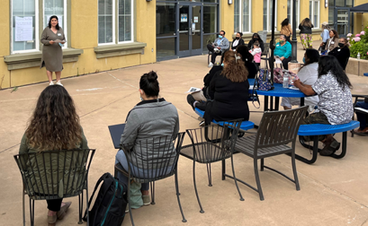
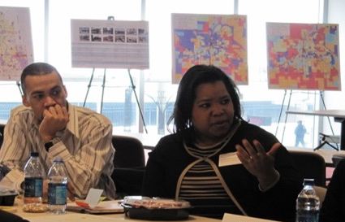
Equity at Link21 Core
Equitable Engagement, Analysis, and Planning
Direct and accessible engagement
Co-Creation
Prioritizing communities that have been marginalized
Partnering to understand needs and identify opportunities
Equity Advisory Council (EAC)
Benefiting those who need it most
Notes:
Nicole
A critical component of the Link21 Program is Equity which is embedded in all workstreams.
We know that equitable processes create equitable outcomes and by prioritizing open and transparent engagement with priority populations and communities that have been marginalized, Link21 will be better able to design and deliver equitable train service that meets the priorities, needs, and values of our communities.
To identify priority populations, Link21 used census tracts, partnered with community-based organizations, and conducted polling to establish Program specific geographic areas most impacted by inequitable outcomes.
With equity at the core of Link21, we are committed to planning and developing projects differently and in partnership with the communities we serve.
There are three components or strategies that are guiding our Equity Program and they are:
Equity Integration in our planning and technical analysis. As an example, as we performed our market analysis last year, priority populations were given a higher weighting to help define those areas where we might improve existing service or grow ridership by connecting people who do not have access to rail today.
Link21 has also established a Community Based Organization partnership program where we can Co-Create with our partners and their communities.
We have had three successful rounds of Co-Creation already and plan to hold another three rounds over the next 12 to 18 months.
And before the year is out, we will have established our Equity Advisory Council
The EAC will select 20 members who will be charged with helping to guide project development and program decisions with an equity lens.

Slide 8
What We’ve Accomplished
PHASE 0 (2019 – 2022)
PHASE 1 (2022 – 2024)
PHASE 2 (2024 – 2028)
PHASE 3 (2029 – 2039)
PROGRAM DEFINITION
PROJECT IDENTIFICATION
PROJECT SELECTION
PROJECT DELIVERY
KEY WORK ACTIVITIES
Planning: Early visioning, Program identification and decision framework
Engineering Analysis: Market analysis, service survey, technical studies
Early Environmental Work: Social and natural resource data collection
Public Engagement: Co-creation and stakeholder / public workshops
Notes:
Nicole
Phase 0 set the foundation for the work we are now conducting
Some of the key highlights included:
Establishing goals and objectives
A decision-making framework that will guide planning
Gathering initial data through technical studies, service surveys, market analysis
Engaging stakeholders and the public to gather initial input.
This initial phase also set up the targeted equity program that is embedded in all the work we do.

Slide 9
Phase 1 Focus
PHASE 0 (2019 – 2022)
PHASE 1 (2022 – 2024)
PHASE 2 (2024 – 2028)
PHASE 3 (2029 – 2039)
PROGRAM DEFINITION
PROJECT IDENTIFICATION
PROJECT SELECTION
PROJECT DELIVERY
KEY WORK ACTIVITIES
Planning: Concept identification, service planning & ridership modeling
Evaluation: Concept testing, evaluation & initial screening
Engineering Feasibility: Studies on concepts
Early Environmental Work: Identification of constraints & opportunities
Public Engagement: Ongoing equitable engagement through planning
Notes:
Nicole
As I stated earlier, our goal for this current work is to identify potential Projects to move into environmental review.
To do that, we will start with development of initial concepts.
Concepts will be informed by the market analysis, service planning, ridership modeling, environmental work and timely public input.
Concepts will be refined using several metric or considerations to make sure they meet our Programs Goals and Objectives.
As Concepts are further refined and analyzed a Project or Projects will emerge for consideration and further examination.

Slide 10
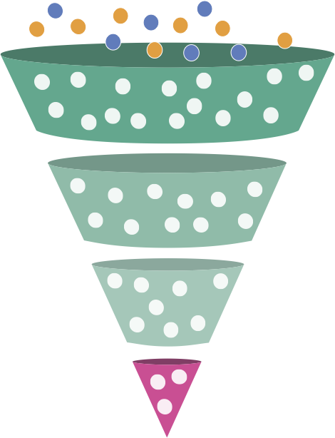
Project Identification Process & Public Input
CONCEPTS
ANALYSIS
PUBLIC INPUT
CONCEPT EXPLORATION:
Test concepts to inform initial list
WE ARE HERE
FALL 2022
CONCEPT EVALUATION / REFINEMENT:
Evaluate initial concepts
SPRING 2023
CONCEPT EVALUATION / REFINEMENT:
Evaluate shortlisted concepts
FALL 2023
PROJECT IDENTIFICATION:
Move project(s) to environmental review
SPRING 2024
FIRST QUARTER 2024
PHASE 2 INITIATES
PROJECT ALTERNATIVES
Notes:
Nicole
To get to identification of Projects that could contain multiple alternatives, we first need to start with development of Concepts.
Evaluation of these concepts will be a multi-step process that incorporates public input at each step of the way.
We will start with a long list of initial concepts that is informed by public input we are gathering now.
Concepts will go through two rounds of screening and refinement with more detailed analysis each time.
Key evaluation considerations include things like public input, cost effectiveness, ridership and more.
The initial concept list will be released early next year and go through the first round of evaluation.
Our plan will be to come back out to the public following that first screening in Spring of 2023.
Ultimately we will engage again following the second screening around Fall 2023 prior to identifying projects to move forward into Phase 2 Environmental Review.
Phase 2 is the Environmental review and of course would initiate further definition around Projects that may include multiple alternatives.

Slide 11
Integrated Environmental Focus
PHASE
Environmental Constraints & Opportunities (ECO) Identification
PHASE
Comprehensive Environmental
Analysis
1
2
PROJECT IDENTIFICATION (2022 – 2024)
PROJECT SELECTION (2024 – 2027)
Social and natural constraints and opportunities to support concept development
ECO Report and map book available at Link21Program.org
ECO informs project alternatives
California Environmental Quality Act (CEQA) & National Environmental Policy Agency (NEPA)
Notes:
Nicole
To help us identify concepts that will best serve our diverse communities, Link21 has integrated and initiated early environmental work during Phase 1.
The goal of this work is to learn and understand current environmental constraints, and potential opportunities to inform Concept development and guide decisions.
Conducting this environmental work early helps to set us up for a more successful environmental process in the next phase of planning where Projects alternatives will be analyzed to determine potential impacts to the environment such as community impacts, noise, air quality, and other environmental resources.
During Phase 2 the Program will also determine potential solutions or what is called mitigations to minimize impacts identified.
You can learn more about the early environment work on the website where you can find the Environmental Constraints and Opportunities Report.

Slide 12
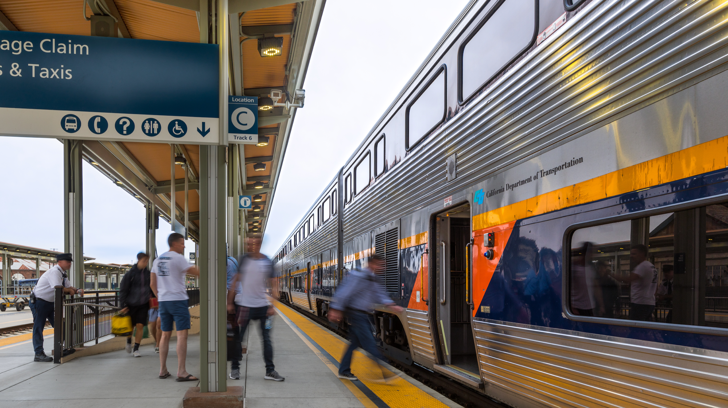
Developing Initial Concepts
Notes:
Nicole introduces Aidan

Slide 13

Identifying Link21 Concepts
Concepts are built from four key building blocks to best serve riders
MARKETS
SERVICE
TECHNOLOGY
INFRASTRUCTURE
People, travel patterns, and their preferences
Schedule, travel time, and frequency
Types of trains
Physical improvements
to train network
Notes:
Aidan
Will share some example concepts shortly, but first, want to remind those who have been involved and share with those that are new to Link21 how concepts are created.
Link21 concepts are made from four building blocks
Markets refers to the places that could be served by a new or improved train network.
While our market analysis identified the most popular destinations that people are traveling to are areas within San Francisco and the Peninsula and areas in Oakland and the East Bay, there are other key destinations identified that extend further out throughout the Megaregion demonstrating the need for a better connected network.
Link21 is considering improvements in train service for both BART and Capitol Corridor and consideration of train technology for both as well.
However, when we say train technology, we are not talking about the trains of today but rather newer train technology of the future.
Link21 is planning for a future with modern trains that are greener, lighter and faster.
Modern Regional Rail trains can operate like an urban metro service and also serve longer distance corridors.
Lastly, to improve service and access, Link21 will need to improve existing infrastructure which are things like stations, the crossing itself, track work, etc.
Putting these building blocks together, Concepts will show places that could be served by train, types of service that could improve rider experience, new train technology, and key infrastructure improvements to meet travel needs and improve operations for both BART and Regional Rail.

Slide 14
Transbay Rail Potential (Equity Weighted)
Sacramento Co.
Fairfield/Vacaville
Vallejo
Martinez
West Contra Costa Co.
Stockton/Lodi
Central Contra Costa Co
North Oakland/Emeryville
West San Francisco
San Ramon
Tracy/Manteca/Lathrop
Stanislaus Co.
Fremont/Union City
Central/South San Mateo Co.
Central/South Santa Clara Co.
Salinas/Santa Cruz/Monterey
Notes:
Aidan
Having shared the building blocks of Concepts for Link21, want to focus quickly on what we have learned through a market analysis that was conducted last year.
The Market Analysis estimated where the people across the megaregion might use rail to travel through the Transbay Corridor (between Oakland and San Francisco)
Blue dots are the areas with the greatest amount of rail potential, and not surprisingly, that potential increases the closer people are to the crossing.
This analysis was equity weighted, meaning areas with priority populations given a higher weight than those without.
Much of these areas are already served by BART and other rail and transit operators but this analysis indicates there is an opportunity to improve upon the existing service and maybe serve some communities that have little to no rail service.
We also understand that Western San Francisco is a potentially strong market for generating Transbay rail trips particularly to serve priority populations.
Important to note that the “blue dots” alone don’t tell us where improved rail service is needed. Link21 team also considered whether locations already have access to other high-capacity transit service (ferry, light rail, express bus) and whether the communities could support a rail station with many residences and businesses within close proximity.
We are using this information, along with public input and results from our previous service survey, to develop initial concepts.
The concepts will target new/improved train service to places with greater rail potential.
While this map alone does not tell the whole story, it is one part of the many considerations that are being addressed as the team looks for travel solutions.

Slide 15
Link21: New Trains and Service
BART
MODERN REGIONAL RAIL
URBAN METRO SERVICE
MODERN REGIONAL RAIL
LONG DISTANCE SERVICE
FREQUENCY
More frequent trains
Every 2-30 minutes
(varies by route/time of day)
Less frequent trains
Every 30 minutes
(varies by route/time of day)
Similar to BART
STOPS
1-5 miles apart
Similar to BART
5+ miles apart (express service)
TRACK
Designated BART only
Shared with national network
Shared with national network
SERVICE AREA
Urban/Suburban Areas
Within 5-County BART District
Urban/Metro areas
Urban/Suburban Centers
Across 21-County Megaregion
NEW TRAIN TECHNOLOGY that is greener, lighter, and faster
Notes:
Chester
Service and Vehicle technology are the second and third building blocks. Service is being planned so that people traveling short, medium, and long distances will see improvements. We are also looking at how to run trains more frequently, make trips faster, and extend operating hours where possible.
You may be familiar with BART trains, high frequency, short distances between stops
You may not be as familiar with Modern Regional Rail trains; compared with today, will be greener (not diesel-powered), faster, can offer passengers different types of service for those short, medium, and long trips, more similar to BART
The train characteristics shown here demonstrate the different types of service that will be possible with new modern train technology as planned by Link21, and as envisioned in the State Rail Plan.
Caltrain (you might be familiar with) is a good example of a regional rail urban metro service (middle column) that is moving towards greener solutions, converting to electric-powered trains in just a few years.

Slide 16
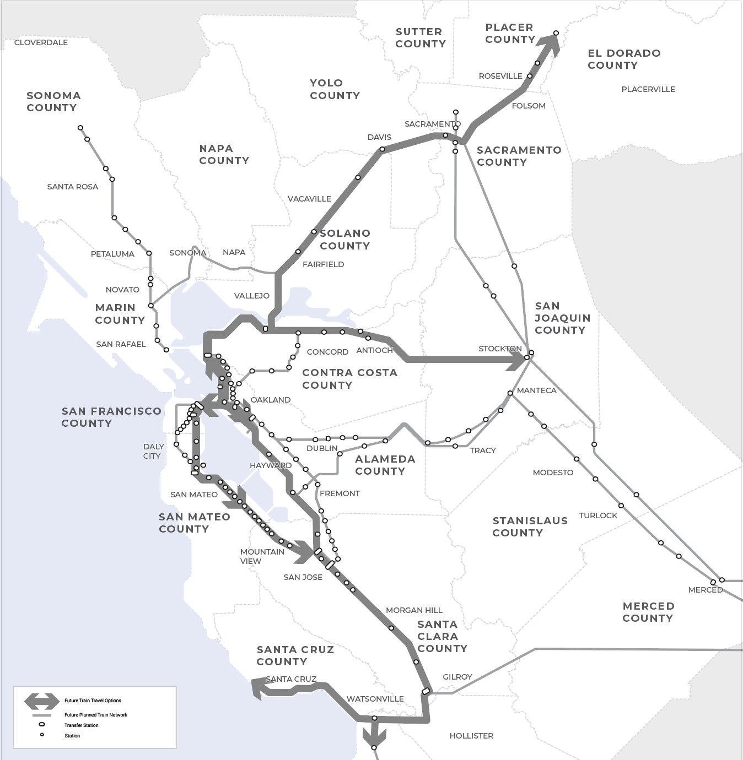
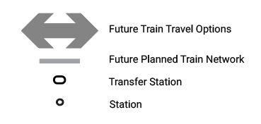
Link21 Unlocks Travel Potential
Markets
Better Megaregional connectivity
Service
Improved travel, frequency with some
one-seat rides, and faster transfer opportunities
More capacity, service redundancy and reliability, between BART and Regional Rail
Technology
Greener, lighter, and faster trains
Infrastructure
Enhanced tracks, signaling, structures, and facilities
Notes:
Aidan
Have talked about markets, service, technology, and now I’ll discuss how those building blocks, plus infrastructure will create concepts for Link21.
One of the key components of the concepts is a new crossing of the Bay which will encourage more people to take the train and offer an alternative to congested roadways.
This map illustrates how a new rail crossing unlocks local and regional travel benefits rail across the whole rail network. In other words, people that are far from the crossing will benefit from being able to travel by rail between places that currently do not have very efficient or convenient rail service.
For example, we have heard from the public many times that they would love to travel from Sacramento to San Francisco and the Peninsula, or the Peninsula to the inner East Bay with fewer or no transfers and in way less time.
This could be possible with a second rail crossing that accommodates regional rail and other key improvements that will address BART capacity and reliability issues.
These train network improvements are being identified and included within a range of different Link21 Concepts such as:
new crossings for both regional rail and BART
a new crossing for regional rail
a second BART crossing
Along with the crossing, Concepts will include connections to the other service (example RR must connect to BART and visa versa)
Concepts will also have other key infrastructure improvements like the crossing, enhanced or new stations, etc.
Each Concept developed is able to operate and provide benefits on its own and also won’t impede other planned and proposed projects.
Ideally, potential concepts will enhance other projects to deliver even greater benefits systemwide.

Slide 17
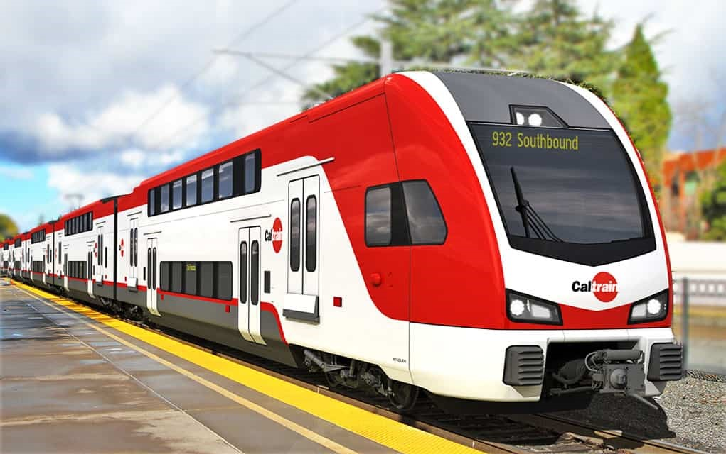
Future Rail Planning – San Francisco
Caltrain Electric Train
Caltrain
Electrification & future service increase
(six trains/hour initially by 2024)
Downtown Rail Extension (DTX)
  Service to Salesforce Transit Center (Caltrain & High-Speed Rail)
  4th & Townsend Station (underground)
Geary and 19th Avenue Transit Corridor Study
Bayview Caltrain Station
Transbay
Joint Powers Authority
SFMTA/SFCTA
SF Planning
SFCTA
Notes:
Aidan
Link21 is a collaborative effort, and we are in regular communication with local agencies and stakeholders.
We keep them informed of our progress and together we track the progress on the local projects and planning efforts that will influence our work.
Some of those projects and planning efforts are shown on the slide:
We are working with Caltrain to understand how their current plans and service vision get built into a new rail crossing
And with TJPA to make sure that the design of DTX and the Salesforce Transit Center rail box can accommodate the regional rail crossing Concepts
SFCTA, in partnership with SFMTA, and SF Planning are leading a planning effort in the Geary and 19th Avenue Transit Corridor Study and we are working with them to make sure that our Concepts will be flexible enough to meet the transit needs in that corridor
And finally, we have been tracking the planning efforts for a potential new Caltrain station in the Bayview so that we can assess how that should be addressed in our planning work

Slide 18
Reviewing EXAMPLE Concepts
Key things to keep in mind with EXAMPLE Concepts:
  No decisions have been made
  Does not demonstrate exact alignments
  Represents general ideas
  Does not include other rail improvements
Notes:
Aidan
These examples we are about to show are representative of what could be included in Concepts that will be released after the new year.
There have not been any decisions made on Link21 Concepts but rather we are here to gather input to help further refine the initial Concept list
The examples we will show this evening do not include other key rail improvements that will be included in future concepts.
For instance: A concept that has Regional Rail in a new crossing, could also include non-crossing improvements to the BART system or visa versa.

Slide 19
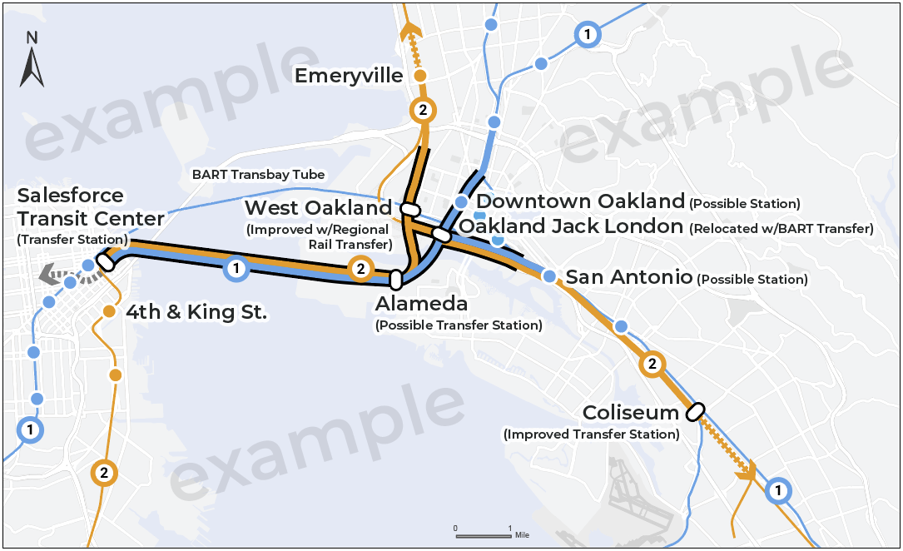
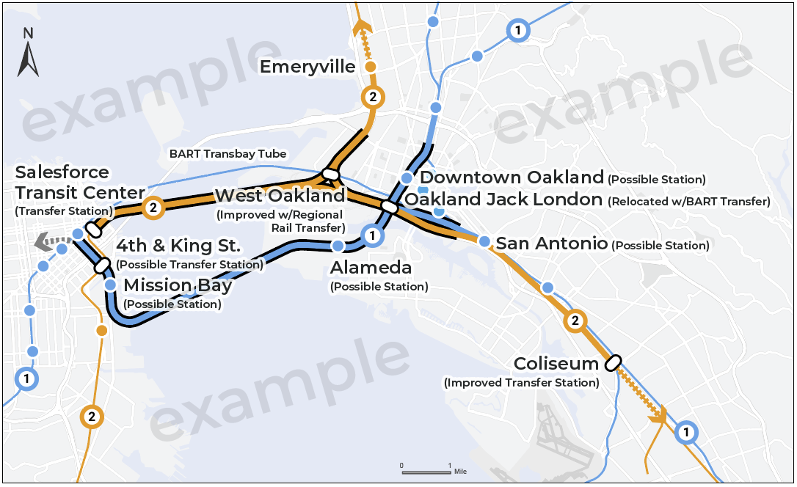
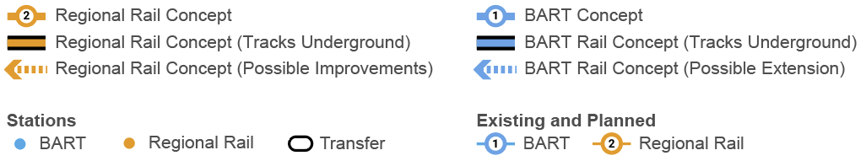
Example Concepts:
Regional Rail & BART in Crossing
ONE ALIGNMENT - TWO STRUCTURES
TWO ALIGNMENTS - TWO STRUCTURES
Notes:
Aidan
In early 2023, there will be a full set of initial concepts that will be shared and further evaluated.
Here are a couple of examples of the initial Concepts that are being explored.
For reference, on these maps:
Orange represents Regional Rail like Capitol Corridor, ACE, Caltrain, San Joaquins etc.
Blue represents BART
Thick lines are new or improved rail alignments; Thin lines are existing ones
The Black outline represents what would be below ground; no outline shows where alignments would be on or above ground.
Both orange and blue lines show where a Transbay crossing could connect to the existing rail network on either side of the Bay, in other words, we are not proposing not an independent rail service that “shuttles” back and forth across the Bay.
Regional Rail and BART run on different types of tracks which is the main reason why they couldn’t share the same crossing.
A BART crossing and a Regional Rail crossing could both advance and be built as demonstrated in the maps shown; We are looking at how we might do that with crossings that complement and do not conflict with each other
These two examples show how regional rail and BART might cross the Bay – the example on the left shows them side by side and the one on the right where they cross in different locations. Both configurations have pros and cons.
We’ve learned that having the two types of rail together side-by-side as shown on the left is not necessarily a huge cost saver, whereas the concept on the right is an advantage of being able to serve a few more communities by having the lines in separate locations with several new stations.
As we go through the next several months of concept development and evaluation, we will learn more about the benefits of each crossing.
The next two slides show the same concepts that you see here, but separately to simplify the visuals.

Slide 20
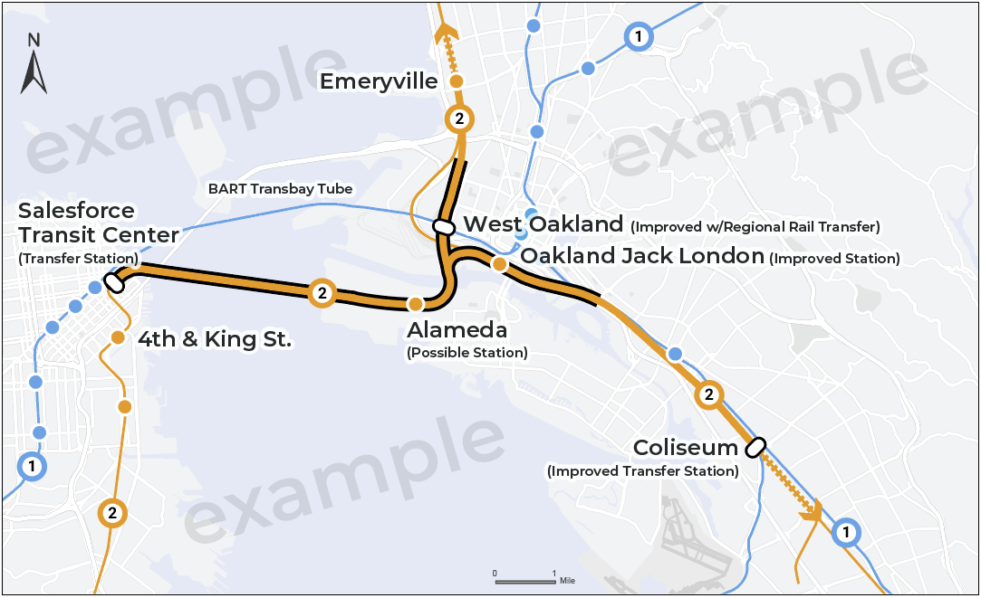
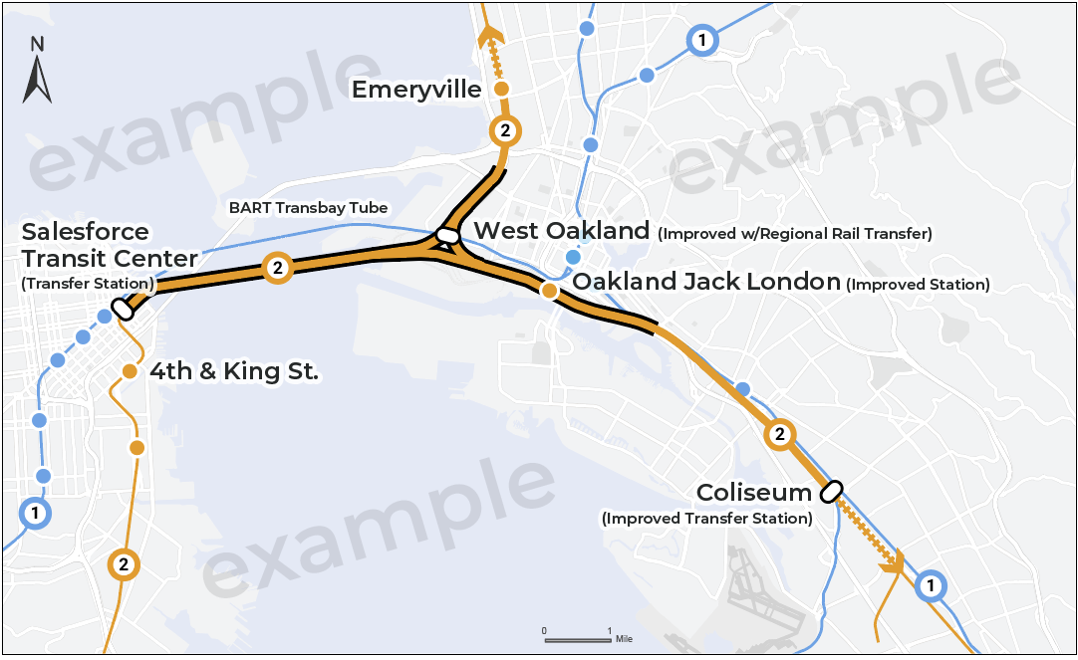
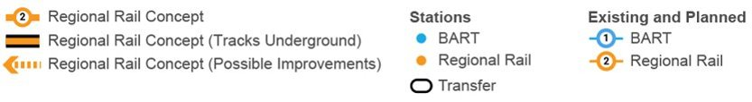
Example Concepts:
Regional Rail in Crossing
ALAMEDA TO SALESFORCE TRANSIT CENTER
EMERYVILLE TO SALESFORCE TRANSIT CENTER
Notes:
Aidan
As you just saw, these are the previously shown Regional Rail Example Concepts focused on the crossing of the Bay.
A new Regional Rail crossing could offer another way to cross the Bay besides the existing BART crossing building capacity and reliability while also adding new connections between existing Regional Rail lines in East Bay and SF/Peninsula
Today, Regional rail is designed to serve medium- to long-distance travelers, so service generally covers longer distances and doesn’t stop as much.
With modern trains as discussed earlier, regional rail could also function more like a metro system like BART, in dense urban areas (stopping more often but doing so quickly and having more-frequent trains); trains are already used this way in other major cities around the world.
In these examples, Regional Rail in San Francisco connects to Salesforce Transit Center’s underground station and the future Downtown extension to connect to the existing Caltrain rail line on the Peninsula.
This would allow Caltrain to run through to East bay and trains from East Bay like Capitol Corridor to cross the Bay into San Francisco.
These concepts differ in the East Bay, showing different communities that could be served directly by the new crossing.
On the left, Regional Rail could go to Alameda then through west Oakland before serving those longer-distance trips beyond the map. This might increase travel time because it travels a less direct route across the Bay to San Francisco.
On the right, it could go directly to West Oakland, for faster travel to farther destinations.
These key markets were identified as locations with the highest transbay rail potential in the market analysis highlighting both a need to improve service where it exists today and to potentially add service to neighborhoods where it currently does not exist, like in Alameda.
Improvements would be made beyond the crossing too – e.g., north of Emeryville on to Richmond – to allow more trains per hour, and more reliable (on-time) service
We also want concepts to provide good transfer connections between Regional Rail and BART: as shown at the Oakland Coliseum station and a possible new transfer in West Oakland.
These are in addition to the existing Richmond station, where improvements could make it easier to transfer between BART and Regional Rail.
In these example concepts, if regional rail were to be built in the crossing first, we are studying how regional rail would alleviate BART capacity issues and help BART passengers, when there are BART system delays or if the existing BART Transbay tube needs to be closed for maintenance or other reasons.

Slide 21
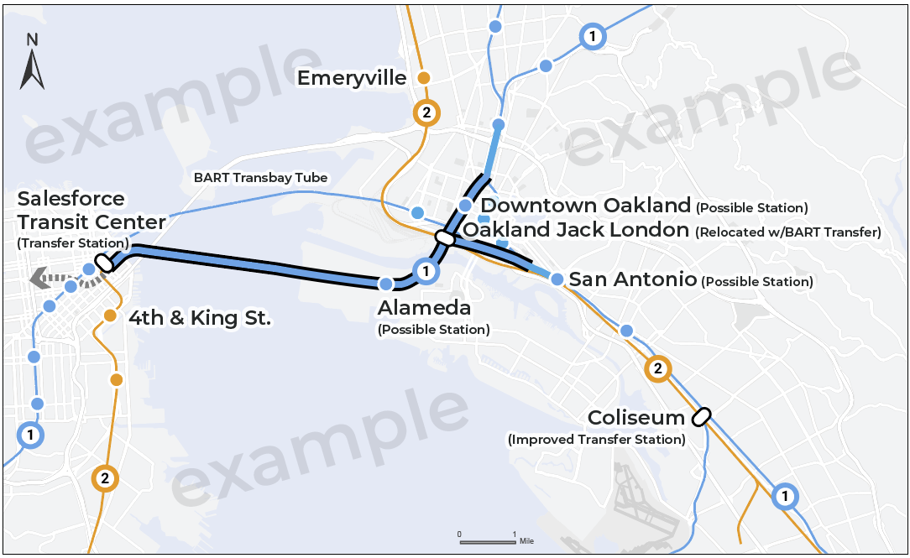
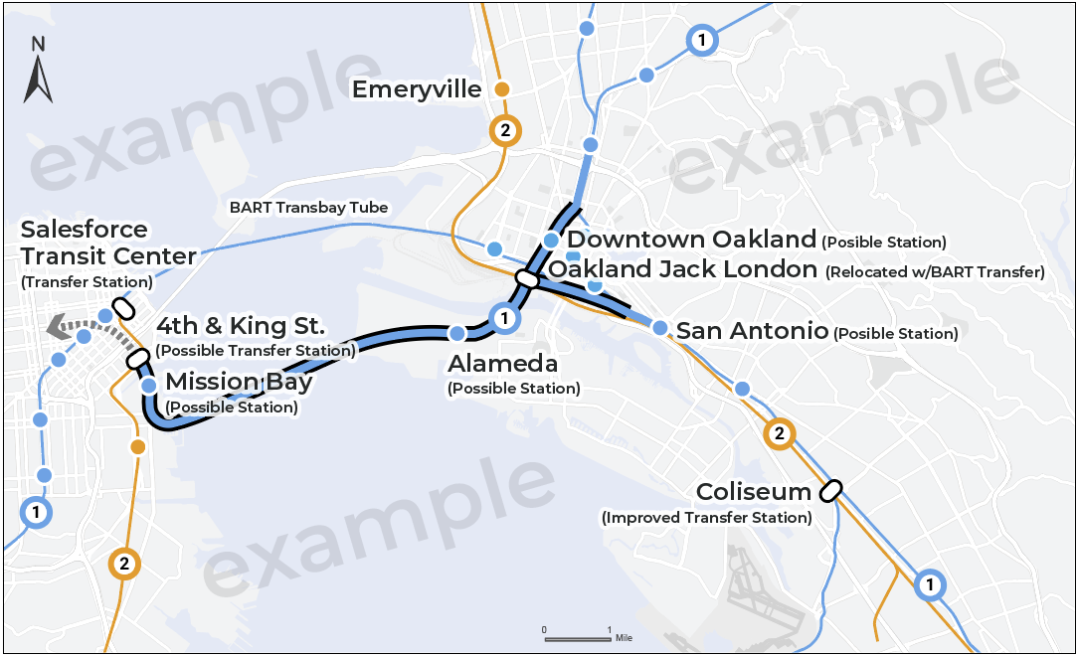
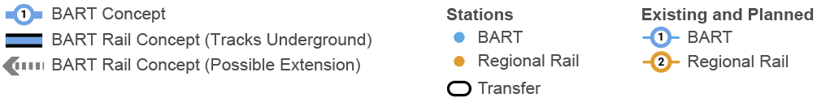
Example Concepts:
BART in Crossing
MACARTHUR TO MISSION
MACARTHUR TO MISSION BAY
Notes:
Chester
These are examples concepts that show a second BART crossing
A new BART crossing could increase the capacity within the crowded transbay corridor, provide service redundancy and reliability to the existing BART crossing in case of service disruption, and allow BART to expand operating hours (later at night or on weekends.)
Concepts will explore a range of different BART alignments (in blue) to serve different communities
These examples show that the connection in San Francisco to key transit transfers near Market Street like the existing BART line on Market Street and with Caltrain (note: does not join back up with existing BART Market Street line)
On the east bay side, these examples are similar:
They both could serve Alameda, a community currently not served directly by BART
They both show a potential new station in the downtown Oakland area
They also include a potential new station in the San Antonio neighborhood of Oakland
Both examples join back up with the existing BART network (all lines – Richmond, Antioch, Dublin-Pleasanton, Warm Springs)
And include more-convenient transfers with Regional Rail at Oakland Jack London Square which would be new, and the Oakland Coliseum which could be an improved transfer.
In SF:
The example concepts could provide transfers to the existing BART lines along Market Street (shown in thin blue)
Link21 concepts will be compatible and could possibly connect to or even include parts of a future western San Francisco rail extension along Geary Blvd and 19th Avenue. (a related project being studied by SF agencies).
The grey dotted arrow that you see on the left of the map represents this potential future connection to other parts of San Francisco beyond Downtown.
Example concepts have variations such as whether to serve additional communities like Mission Bay in San Francisco on the left, vs. more closely provide redundancy to the existing BART crossing on the right.
Concepts will also explore where more-convenient transfers could occur between BART and Regional Rail
As an example, on the left a transfer to Caltrain at Salesforce Transit Center and on the right a transfer to Caltrain at 4th/Townsend Station
As a reminder, these example concepts do not represent exact alignments and no decisions have been made.
For instance, we are looking at multiple options in Oakland so that Link21 fits within Oaklands vision to remove the I-980 freeway should that advance forward.
The Link21 team is working to develop initial concepts that will be further defined through ongoing evaluation and input over the next 15 months so that we can identify a future project or projects to move forward to help solve our travel challenges.

Slide 22
Stay Engaged
SPEAKERS BUREAU & GRASSROOTS
WEBSITE
SOCIAL MEDIA
Tabling at
rail stations and
in neighborhoods
855-905-Link (5465)
Electronic sign-ups, information library, comments submittal
Link21Program.org
Follow BART and
Capitol Corridor on Facebook, Instagram, Twitter & LinkedIn
#Link21
Notes:
Lisbet
Thank you for taking the time to answer our questions.
We appreciate your participation in this webinar and want to remind you that there are other opportunities for engagement in the Link21 Program.
Our team is out in the communities presenting, sharing information, and answering questions.
You might see us at train stations, community events, or other places and if your interested in having the Link21 team present to your organization, please contact us via our telephone line at: 855-905-LINK
Our website at: Link21Program.org

